Slide 1
Data Analytics: Module-2.1
Dr. Ramen Pal Associate Professor Department of CSE (AI & ML), UEMK
Contact: ramen.pal@uem.edu.in WhatsApp: 7501038078

Slide 2
Course Details
Subject Name: Professional Elective - III : Data Analytics
Credit: 3
Subject Code: PECCSE602A
Lecture Hours: 36

Slide 3
Course Outcome
On completion of the course students will be able to:
CO-1: Discuss with illustration the techniques and methods related to the area of data collection, pre-processing, and exploratory data analytics.
CO-2: Discuss important terms and techniques on statistics to enable student to understand the background of different tools or methods used in data analytics.
CO-3: Use at beginning level of proficiency on the tools of machine learning to ask questions of and explore patterns in data.
CO-4: Demonstrate intermediate proficiency in the visualization of data to communicate information and patterns that exist in the data.

Slide 4
Syllabus: Module-2 (Probability, Statistics and Random Processes)
Probability, Statistics and Random Processes: Probability theory and axioms, Random variables, Probability distributions and density functions (uni-variate and multivariate), Expectations and moments, Covariance and correlation, Statistics and sampling distributions, Hypothesis

Slide 5
Introduction
It has become accepted in today’s world that in order to learn about something, you must first collect data.
Statistics is the art of learning from data.
It is concerned with the collection of data, its subsequent description, and its analysis, which often leads to the drawing of conclusions.

Slide 6
Set of data
Yearly precipitation totals,
Earthquake occurrences,
The unemployment rate,
The gross domestic product,
The rate of inflation,
Stock market data, etc.
Statistics can be used to describe, summarize, and analyze these data.

Slide 7
If DATA isn’t available
statistical theory can be used to design an appropriate experiment to generate data.
The experiment chosen should depend on the use that one wants to make of the data.
Problem: Suppose that an instructor is interested in determining which of two different methods for teaching computer programming to beginners is most effective?

Slide 8
If DATA isn’t available: Example
The instructor might divide the students into two groups, and use a different teaching method for each group. At the end of the class the students can be tested and the scores of the members of the different groups compared.
[Condition: It is essential that the students were divided into groups in such a manner that neither group was more likely to have the students with greater natural aptitude for programming.]

Slide 9
Condition: Why?
For instance, the instructor should not have let the male class members be one group and the females the other.
For if so, then even if the women scored significantly higher than the men, it would not be clear whether this was due to the method used to teach them, or to the fact that women may be inherently better than men at learning programming skills.
The accepted way of avoiding this pitfall is to divide the class members into the two groups “at random.”
This term means that the division is done in such a manner that all possible choices of the members of a group are equally likely.

Slide 10
Descriptive Statistics
At the end of the experiment, the data should be described.
For instance, the scores of the two groups should be presented.
In addition, summary measures such as the average score of members of each of the groups should be presented.
This part of statistics, concerned with the description and summarization of data, is called descriptive statistics.

Slide 11
Inferential Statistics
Now, the preceding experiment is completed and the data are described and summarized.
We hope to be able to draw a conclusion about which teaching method is superior.
This part of statistics, concerned with the drawing of conclusions, is called inferential statistics.

Slide 12
How to draw a conclusion?
We must take into account the possibility of chance.
For instance, suppose that the average score of members of the first group is quite a bit higher than that of the second.
Can we conclude that this increase is due to the teaching method used?
Or is it possible that the teaching method was not responsible for the increased scores but rather that the higher scores of the first group were just a chance occurrence?

Slide 13
Possibility of chance: Example
For instance, the fact that a coin comes up heads 7 times in 10 flips does not necessarily mean that the coin is more likely to come up heads than tails in future flips.
Indeed, it could be a perfectly ordinary coin that, by chance, just happened to land heads 7 times out of the total of 10 flips.
On the other hand, if the coin had landed heads 47 times out of 50 flips, then we would be quite certain that it was not an ordinary coin.

Slide 14
Probability model
To be able to draw logical conclusions from data, we usually make some assumptions about the chances (or probabilities) of obtaining the different data values.
The totality of these assumptions is referred to as a probability model for the data.
Sometimes the nature of the data suggests the form of the probability model that is assumed.

Slide 15
Data suggests the form of the probability model?
For instance, suppose that an engineer wants to find out what proportion of computer chips, produced by a new method, will be defective.
The engineer might select a group of these chips, with the resulting data being the number of defective chips in this group.
Provided that the chips selected were “randomly” chosen, it is reasonable to suppose that each one of them is defective with probability p, where p is the unknown proportion of all the chips produced by the new method that will be defective.
The resulting data can then be used to make inferences about p.
In other situations, the appropriate probability model for a given data set will not be readily apparent. However, careful description and presentation of the data sometimes enable us to infer a reasonable model, which we can then try to verify with the use of additional data.

Slide 16
Inferential Statistics: Summery
The basis of statistical inference is the formulation of a probability model to describe the data, an understanding of statistical inference requires some knowledge of the theory of probability.
In other words, statistical inference starts with the assumption that important aspects of the phenomenon under study can be described in terms of probabilities; it then draws conclusions by using data to make inferences about these probabilities.

Slide 17
Population and Sample
In statistics, we are interested in obtaining information about a total collection of elements, which we will refer to as the population.
The population is often too large for us to examine each of its members. For instance, we might have all the residents of a given state, or all the television sets produced in the last year by a particular manufacturer, or all the households in a given community.
In such cases, we try to learn about the population by choosing and then examining a subgroup of its elements. This subgroup of a population is called a sample.

Slide 18
History of Statistics
A systematic collection of data on the population and the economy was begun in the Italian city states of Venice and Florence during the Renaissance.
The term statistics, derived from the word state, was used to refer to a collection of facts of interest to the state.
London bills of mortality.

Slide 19
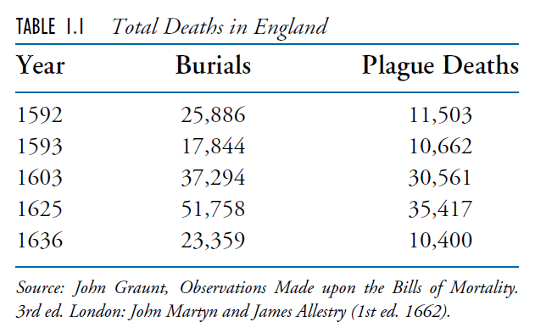
Statistics: The beginning
In 1662 the English tradesman John Graunt published a book entitled Natural and Political Observations Made upon the Bills of Mortality.
Graunt used London bills of mortality to estimate the city’s population.
Graunt surveyed households in certain London parishes (or neighborhoods) and discovered that, on average, there were approximately 3 deaths for every 88 people.

Slide 20
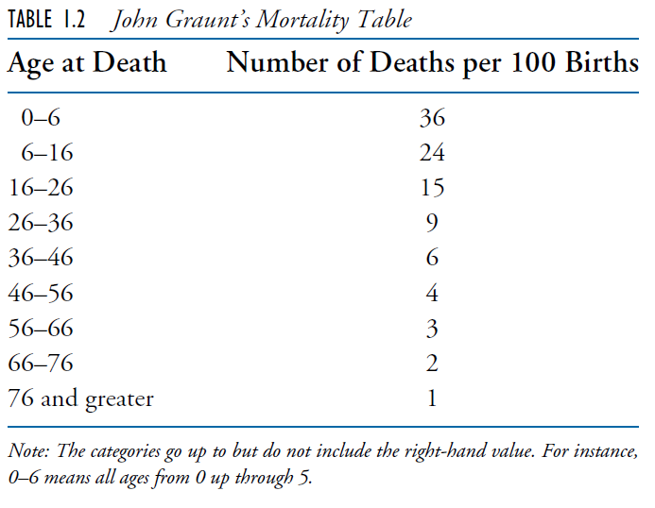
Statistics: The beginning

Slide 21
Conclusion
The term statistics, which was used until the 18th century as a shorthand for the descriptive science of states, became in the 19th century increasingly identified with numbers.
By the 1830s the term was almost universally regarded in Britain and France as being synonymous with the “numerical science” of society.
Throughout the 19th century, probability theory had been developed by such mathematicians as Jacob Bernoulli, Karl Friedrich Gauss, and Pierre-Simon Laplace.
It was not until the late 1800s that statistics became concerned with inferring conclusions from numerical data.
Francis Galton’s work on analyzing hereditary genius through the uses of what we would now call regression and correlation.
Karl Pearson developed the chi-square goodness of fit tests.
W. S. Gosset, a chemist by training developed the Students’ t-test.
Two of the most important areas of applied statistics in the early 20th century were population biology and agriculture. Ronald A. Fisher.

Slide 22
Conclusion
Nowadays the ideas of statistics are everywhere.
Descriptive statistics are featured in every newspaper and magazine.
Statistical inference has become indispensable to public health and medical research, to engineering and scientific studies, to marketing and quality control, to education, to accounting, to economics, to meteorological forecasting, to polling and surveys, to sports, to insurance, to gambling, and to all research that makes any claim to being scientific.
Statistics has indeed become ingrained in our intellectual heritage.

